Slide 1
Design Solutions by using Platform Services

Slide 2
Design for Artificial Intelligence Services
Cognitive Services
Bot Services
Machine Learning

Slide 3

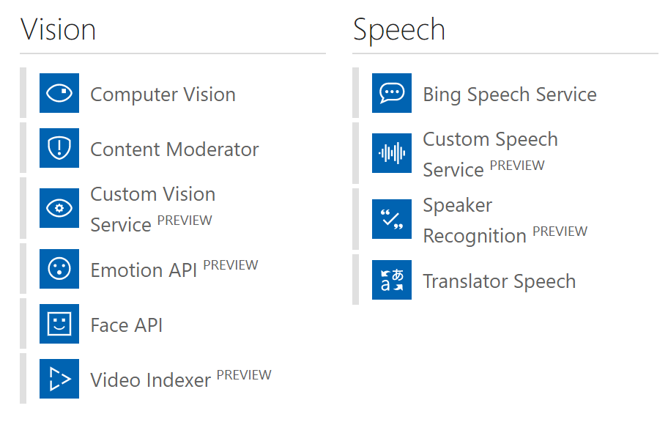
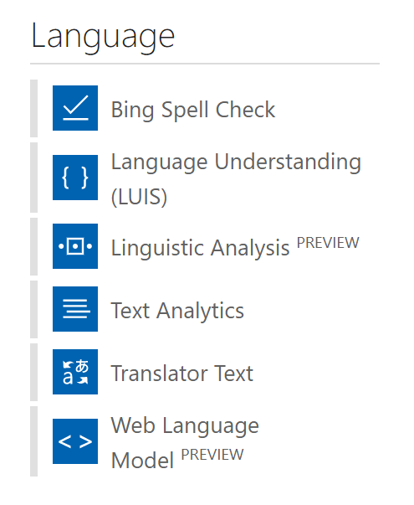
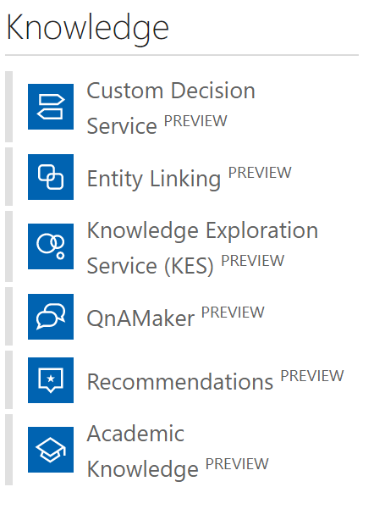
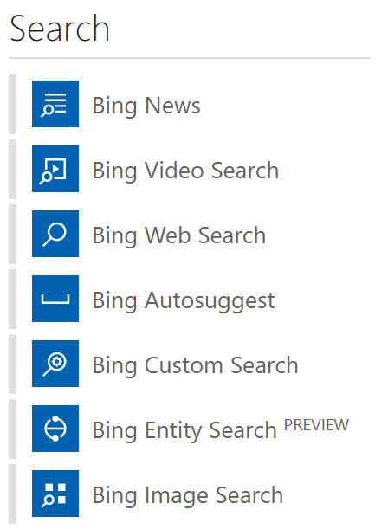
Cognitive Services
Notes:
MACHINE LEARNING FOR THOSE WHO AREN’T AI EXPERTS
CUSTOM VISION SERVICE—REAL TIME VIDEO FEEDS—WHO MIGHT BE CARRYING A WEAPON? PARTNERS IN PUBLIC SECURITY SPACE.
29 comprehensive collection of intelligent and knowledge API to build smarter APPS
Available across platform
Easy integration with your experience
No background Machine learning

Slide 4
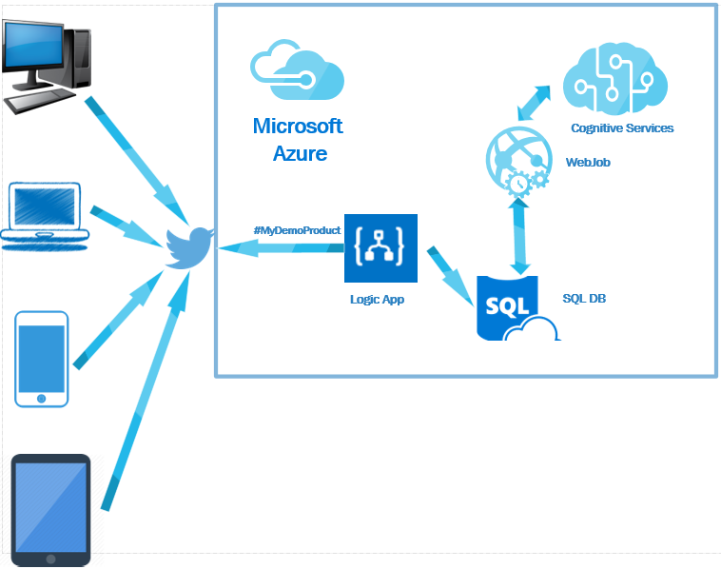
Notes:
Capture tweets from twitter or comments from Facebook and Figure out the sentiment of the tweets.
https://blogs.msdn.microsoft.com/biblog/2016/11/01/build-social-sentiment-analysis-solution-using-microsoft-azure-services/

Slide 5

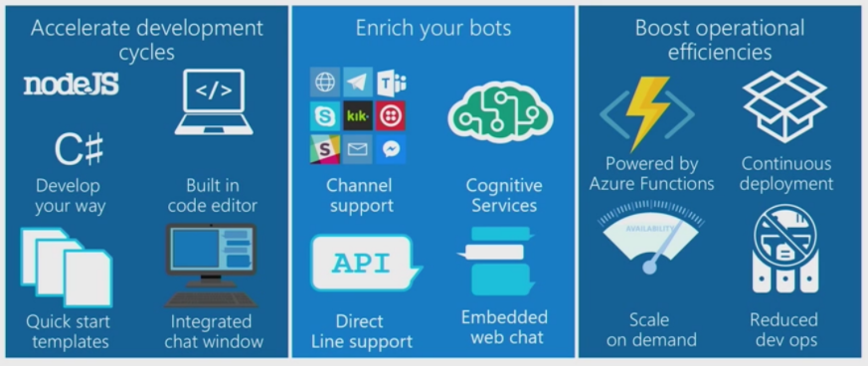
Bot Services
Notes:
Build, connect, deploy, and manage intelligent bots to interact naturally with your users on websites, apps, Cortana, Microsoft Teams, Skype, Slack, Facebook Messenger, and more. Get started quickly with a complete bot-building environment. You’ll pay only for what you use.

Slide 6
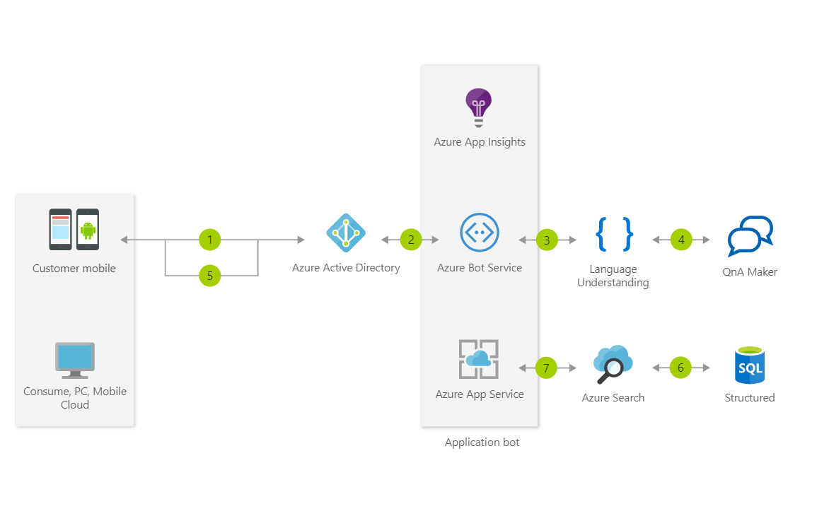
Notes:
This Informational Bot can answer questions defined in a knowledge set or FAQ using Cognitive Services QnA Maker and answer more open-ended questions using Azure Search

Slide 7

Some Modelling Techniques in Azure ML
MULTICLASS CLASSIFICATION
Predict failures with their causes within a future time period
Predict remaining useful life within ranges of future periods
REGRESSION or SURVIVAL ANALYSIS
1001001010
ANOMALY DETECTION
Predict remaining useful life, the amount of time before the next failure
Identify change in normal trends to find anomalies
BINARY CLASSIFICATION
Predict failures within a future period of time
Notes:
AZURE MACHINE LEARNING

Slide 8
Design for IoT
Stream Analytics
IoT Hubs
Time Series Insights
IoT Edge

Slide 9

Stream Analytics
Instantly analyze data from all your IoT devices and gateways
Develop massively parallel Complex Event Processing (CEP) pipelines with simplicity
Start in seconds, scale instantly, pay per job
Build real-time dashboards in minutes
Enterprise grade availability, auditing and support
Notes:
An on-demand real-time analytics service to power intelligent action
Easily develop and run massively parallel real-time analytics on multiple IoT or non-IoT streams of data using simple SQL like language. Use custom code for advanced scenarios. With no infrastructure to manage, you can process data on-demand, scale instantly, and only pay per job.
HIGH AVAILABITY, AUDITING AND SUPPORT
FIND NEEDLES IN HAYSTACKS, PULL THEM OUT AND ACT ON THEM
BIG COMPUTE INFRASTRUCTURE BEHIND IT

Slide 10

IoT Hub
Establish bi-directional communication with billions of IoT devices
Authenticate per device for security-enhanced IoT solutions
Register devices at scale with IoT Hub Device Provisioning Service
Manage your IoT devices at scale with device management
Notes:
Connect, monitor, and manage billions of IoT assets
Get started quickly
Register and provision IoT devices automatically
Connect and manage billions of IoT devices and assets
Establish reliable, bi-directional communication
Enhance the security of your IoT solutions
Ingest real-time data and upload files to the cloud
GUNSHOT—TURN LIGHTS UP—NOTIFY POLICE
ATLANTA IS A SMART CITY
7,000 CAMERAS IN ATLANTA—IoT DEVICES
USE BING / COSMOS DB
COGNITIVE APIs LOOKING FOR DISTRESSED PEOPLE

Slide 11

Time Series Insights
Find actionable insights in seconds
Start in seconds, scale in minutes
Create a global view of your IoT-scale data
Apply Time Series Insights to your apps and solutions
Access enterprise-grade security and support
Notes:
Time Series Insights
The best platform for storing and managing time-series data
Azure Time Series Insights is a fully managed analytics, storage, and visualization service for managing IoT-scale time-series data in the cloud. It provides massively scalable time-series data storage and enables you to explore and analyze billions of events streaming in from all over the world in seconds. Use Time Series Insights to store and manage terabytes of time-series data, explore and visualize billions of events simultaneously, conduct root-cause analysis, and to compare multiple sites and assets.
IMPLEMENTED WITH DOCKER CONTAINERS

Slide 12
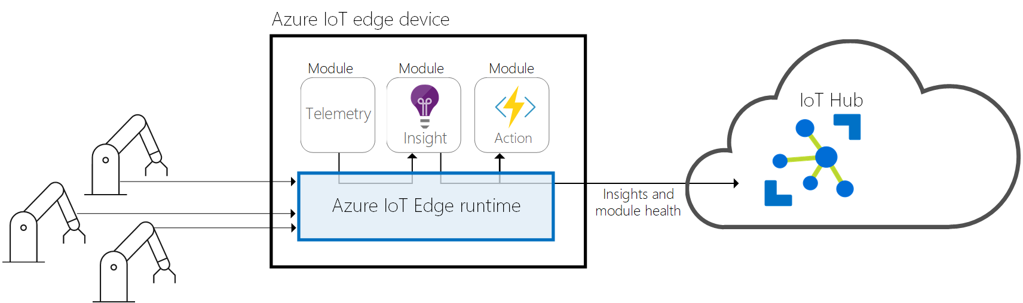
IoT Edge
Extend cloud intelligence to edge devices
Run artificial intelligence at the edge
Perform edge analytics
Deploy IoT solutions from cloud to edge
Manage devices centrally from the cloud
Operate with offline and intermittent connectivity
Enable real-time decisions
Connect new and legacy devices
Reduce bandwidth costs
Notes:
Extend cloud intelligence to edge devices
Run artificial intelligence at the edge
Perform edge analytics
Deploy IoT solutions from cloud to edge
Manage devices centrally from the cloud
Operate with offline and intermittent connectivity
Enable real-time decisions
Connect new and legacy devices
Reduce bandwidth costs

Slide 13
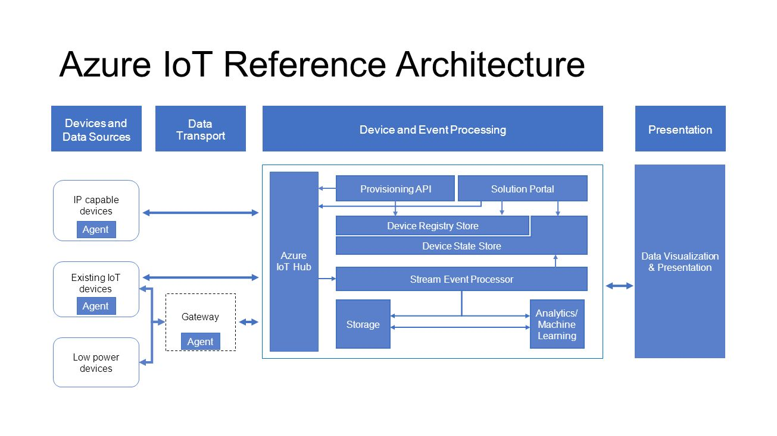
Notes:
USED TO BE CALLED LAMBDA ARCH OR KAPP ARCH

Slide 14
Messaging
Service Bus
Queues
Topics
Azure Relay
Service Bus Tiers
Azure Storage Queue

Slide 15

Service bus
PaaS with no Infrastructure management
Relay capabilities to build hybrid apps
Supports AMQP and common protocols such as HTTP
Contains Event Hub, a cloud scale telemetry ingress service.
Notes:
Service Bus is a multi-tenant cloud service
Microsoft Azure Service Bus is a reliable information delivery service. The purpose of this service is to make communication easier. When two or more parties want to exchange information, they need a communication facilitator.
AMQP Advanced Message Queuing Protocol -- BIG IN IOT SPACE

Slide 16
Service Bus Topic
S
R
Subs
Topic
S
R
R
R
S
R
One to many broadcasting scenarios
Filter messages
Use ReceiveBatch() or ReceiveBatchAsync() to receive a batch of messages
Notes:
RECEIVERS SUBSCRIBE TO A TOPIC, SO MULTIPLE READERS COULD RECEIVE THE SAME MESSAGE
IF A SUBSCRIPTION HAS MULTIPLE READERS, (E.G. MIDDLE RECEIVER ON THE SLIDE) ONLY ONE OF THE READERS WOULD GET THAT MESSAGE

Slide 17
Service Bus Queue
S
R
S
Queue
R
S
R
Point to point communication
FIFO order guarantee
Supports Batch Receive and Batch Send
Notes:
A MESSAGE GETS SENT TO ONE RECEIVER ONLY
LOAD LEVELLING—HIGH VOLUME INTO ONE STREAM
EXAM: GROUPING RELATED MESSAGES INTO A SESSION
AMQP—GROUP

Slide 18
Event Hub
Ingest messages at scale at high throughput, high volume and low latency
Typical use cases are IOT and enterprise logging
Messages are durable for 7 days
No enterprise messaging features such as dead letter queue
Notes:
Azure Event Hubs is a highly scalable data streaming platform and event ingestion service, capable of receiving and processing millions of events per second. Event Hubs can process and store events, data, or telemetry produced by distributed software and devices. Data sent to an event hub can be transformed and stored using any real-time analytics provider or batching/storage adapters
LARGE VOLUME WITH LOW LATENCY
DATA MUST BE OFFLOADED SOMEWHERE IF YOU CAN’T ACCESS IT WITHIN SEVEN DAYS

Slide 19
Connectivity for Hybrid Applications
Azure Relay
Hybrid connections and WCF Relay are part of the Azure Relay service
Communicate with on-premises resources without opening a firewall port
Hybrid Connections support multi-platform scenarios.
Hybrid Connections can be used to connect to any TCP port including SQL DB’s and Web API’s.
WCF Relay can communicate with WCF services and .NET Framework only.
VPN
Connect an Azure Web App to on-premises via VPN.
VNET integration gives a multi tenant Web App Access to resources accessible by an Azure VNET.
App Service Environment (ASE) can be deployed into an Azure VNET for bidirectional access.
Notes:
The Azure Relay service facilitates hybrid applications by enabling you to securely expose services that reside within a corporate enterprise network to the public cloud, without having to open a firewall connection, or require intrusive changes to a corporate network infrastructure. Relay supports a variety of different transport protocols and web services standards.
Windows Communication Foundation
EXAM:EXPRESSROUTE IS PRIVATE CONNECTION.
OFTEN ORGS USE VPN AS WELL—FASTER TO SET UP, CAN FAIL OVER FROM EXPRESSROUTE TO VPN
EXAM: WCF RELAY-.NET FRAMEWORK, OTHERWISE, EXPRESSROUTE OR ?
RRAS CAN BE A VPN ENDPOINT TO GO TO AZURE
DATACENTER TO DATACENTER—CAN USE VPN
POINT TO SITE=TO DISCRETE PARTS OF AZURE

Slide 20
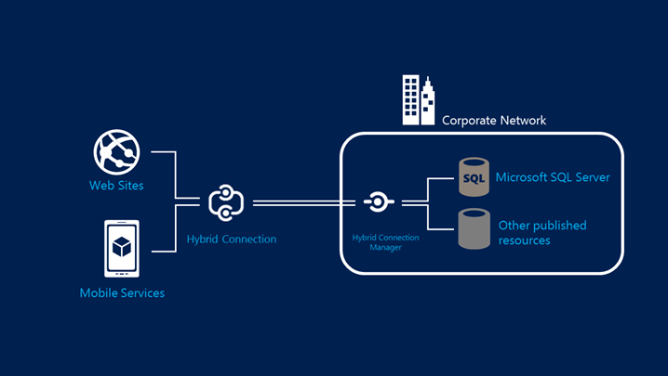
Hybrid Connections Architecture
Notes:
ORIGINATED BY A MICROSOFT ENGINEER IN REDMOND WHO WANTED TO CONNECT TO HIS DAD’S HOUSE IN GERMANY TO ACCESS RECORDED SOCCER GAMES!
NO FIREWALL PORTS NEED TO BE OPENED BUT YOU NEED AGENTS RUNNING AS A SERVICE
HYBRID CONNECTIONS CONNECT TO APP SERVICES, INCLUDING FUNCTIONS, MOBILE APIS
HYBRID CONNECTIONS ARE REALLY SERVICE BUS RELAYS UNDER THE HOOD

Slide 21
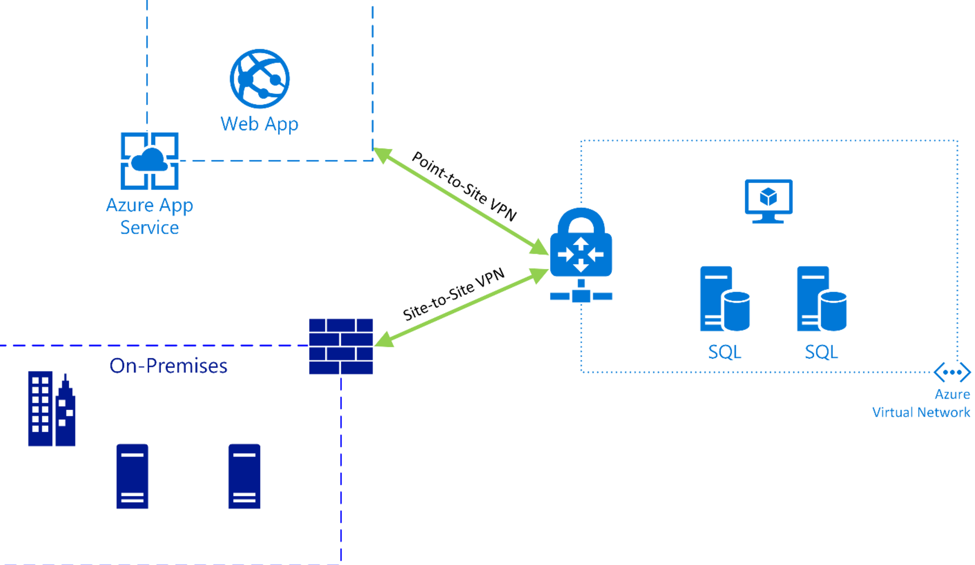
Azure Web App VNET Integration
Notes:
THIS IS WHERE MOST COMPANIES START, I.E. THE LOW HANGING FRUIT
CONTROL WHO HAS ACCESS TO WHAT AND WHAT DATA IS FLOWING WHERE
THINK OF CLOUD AS EXTENSION OF ON-PREMISE NETWORK

Slide 22
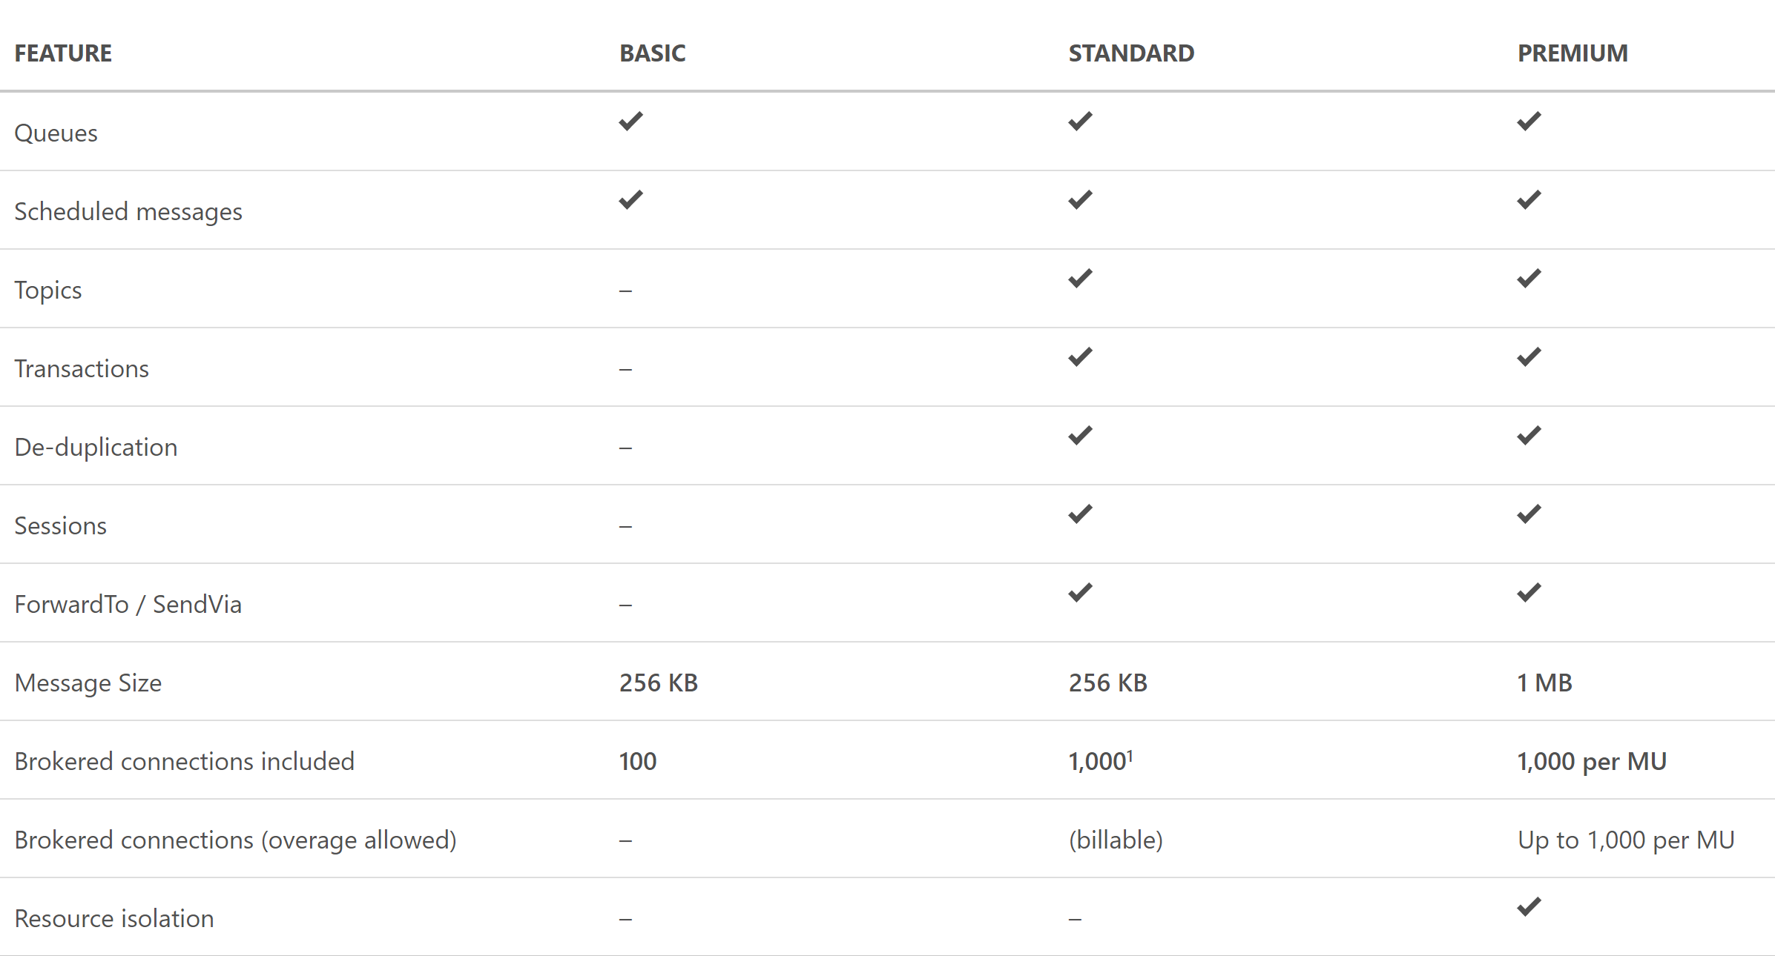
Service Bus Tiers

Slide 23
Integrate Azure Services
Azure Search
Media
Advanced Analytics

Slide 24
Azure Search Overview
1 of 4
A fully-managed search solution that allows developers to enable search experiences in applications.
Embed a sophisticated search experience into web and mobile applications without having to worry about the complexities of full-text search and without having to deploy, maintain or manage any infrastructure.
Perfect for enterprise cloud developers, cloud software vendors, cloud architects who need a fully-managed search solution.
Surface Your Data
Reduce Complexity
Move Quickly with Confidence
Powerful, guaranteed performance
Sophisticated search
Connects business goals to the application
Simplify search index management
Scale-out easily
Fast time to market
Backed by Microsoft Azure
Notes:
LIKE
OR WHERE LIKE
OR WHERE LIKE
FACETED SEARCH

Slide 25
Azure Search
Use Cases
Ecommerce - Searching for products
News Feed – Newer articles are more relevant
Geospatial search – A Search that is aware of your location.
Unstructured content – Index and search documents
Some Features
Term Boosting – Quiet clean hotel
Synonyms – Motel, Hotel
Notes:
HOTEL SEARCH—INCLUDE MOTEL SEARCH BUT DEPRECATE THOSE RESULTS
EXAM: BE AWARE OF INDEX TIERS

Slide 26
Design for media service solutions
Encoding
Media Analytics
Streaming
Content Protection
Content Delivery Network (CDN)
Azure Media Player
Notes:
Encoding
Studio grade encoding enables:
Encoding to multiple formats
Scalable batch processing
Thumbnail, overlay, stitching, and clip generation
High-performance encoing
Web, professional, and broadcast workflow support
ISO- and CDSA-certified highly-secure encoding platform
Media Analytics
Extract advanced metadata using deep-learning based analysis to
Automatically generate standard caption files for your videos
Create smooth and stabilized time lapses from first-person videos
Detect motion, faces and emotion
Summarize videos
Moderate content
Streaming
Deliver content to virtually any device at scale
Just-in-time packaging to HLS, MPEG-DASH, and Smooth Streaming
Just-in-time AES encryption and PlayReady DRM technology
Direct integration with CDN
Scalability to handle all audience sizes
Dynamic manifest manipulation for trimming and rendition filtering
Full cloud DVR workflow capabilities
Content Protection
Deliver highly secure content
Secure content from cloud upload to playback
Use AES clear key and multi-DRM (PlayReady, Widevine, and FairPlay Streaming)
Simplify key management and allow dynamic encryption on the fly
Integrate with Active Directory or your own authentication system
Configure protection rules with simple APIs or web portal
Deliver highly-secure playback with native HTML5 or client SDKs for all device
CDN
Secure and reliable global content delivery and acceleration
Global coverage and massive scalability
Integrated into your Azure services, letting you scale in minutes
Simple setup and no commitment: pay-as-you-go
Azure Media Player
A single player for your content on multiple devices
Supports most popular screens and devices
Automatically chooses the best playback format
Easily integrates into web and app solutions
Lets you use familiar JavaScript API development
Includes automatic fallback for Flash and Silverlight
Gives you integrated content protection

Slide 27
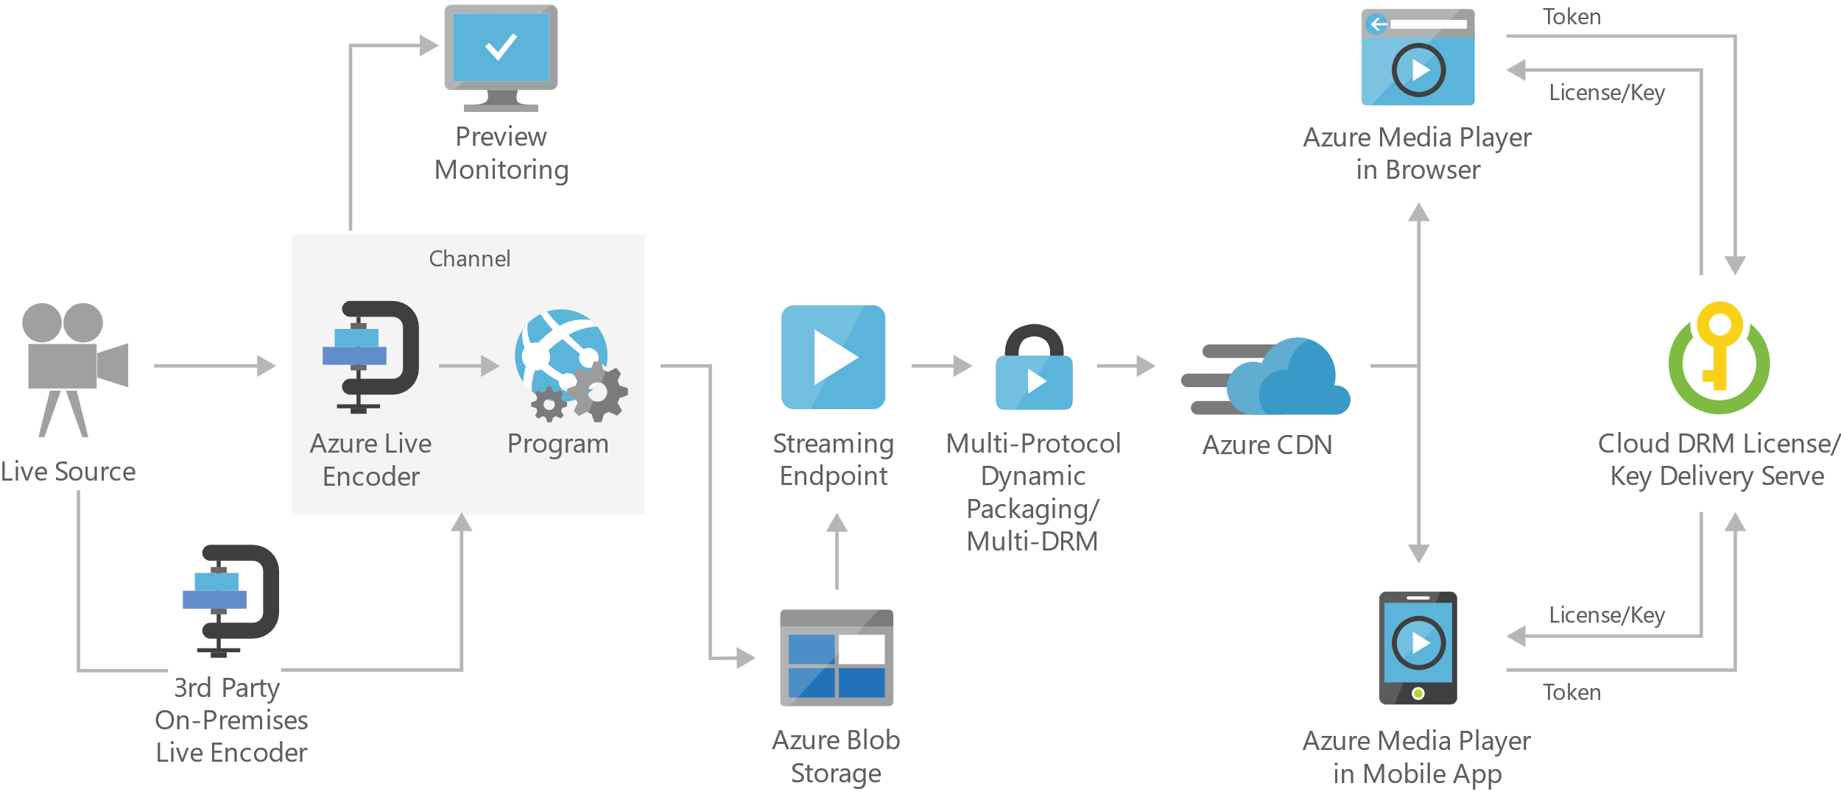
Live streaming digital media
Notes:
On-premises live encoder - Outputs the live source for ingest into the cloud as RTMP, MPEG-Transport Stream, or fragmented mp4 formats.
Preview monitoring - Provides the ability to preview and validate a live stream before further processing and delivery.
Streaming endpoint - Represents a streaming service that can deliver content directly to a client player application, or to a content delivery network (CDN) for further distribution.
Multi-DRM - Delivers content securely using multi-DRM (PlayReady, Widevine, FairPlay Streaming) or AES clear key encryption.

Slide 28



Advanced Analytics
Event production
Collection
Ingestion
Stream Analytics
Storage and
Batch Analysis
Presentation and action
Event Hubs
Event Hubs
Service Bus Queues, Topics
Web/thick client dashboards
Applications
Devices
Stream Analytics
SQL DB, DW
IOT hubs
Legacy IOT (custom protocols)
Search and query
Storage Blobs and Tables
Cloud gateways (web APIs)
Blobs
Document DB
IP-capable devices (Windows/Linux)
Data analytics (Power BI)
Machine
Learning
Azure Data Lake
Low-power devices (RTOS)
Field gateways
Power BI
Devices to take action
Reference Data
more to come…

Slide 29
Azure App Services
Web App
Mobile App
API App
Logic App

Slide 30
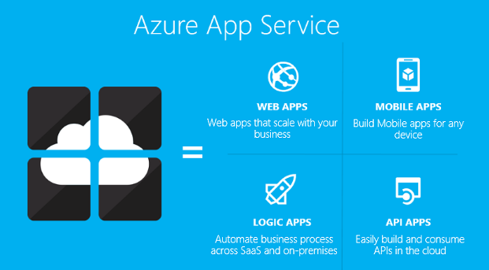
App Service
Authentication
Backup/Restore
Deployment
Networking
Scalability
WebJobs
Notes:
CRUD
Web Apps overview
01/04/2017
Azure App Service Web Apps (or just Web Apps) is a service for hosting web applications, REST APIs, and mobile back ends. You can develop in your favorite language, be it .NET, .NET Core, Java, Ruby, Node.js, PHP, or Python. Applications run and scale with ease on Windows-based environments. For Linux-based environments, see App Service on Linux.
Web Apps not only adds the power of Microsoft Azure to your application, such as security, load balancing, autoscaling, and automated management.
You can also take advantage of its DevOps capabilities, such as continuous deployment from VSTS, GitHub, Docker Hub, and other sources, package management, staging environments, custom domain, and SSL certificates.
With App Service, you pay for the Azure compute resources you use. The compute resources you use is determined by the App Service plan that you run your Web Apps on. For more information, see App Service plans in Azure Web Apps.
Why use Web Apps?
Here are some key features of App Service Web Apps:
Multiple languages and frameworks - Web Apps has first-class support for ASP.NET, ASP.NET Core, Java, Ruby, Node.js, PHP, or Python. You can also run PowerShell and other scripts or executables as background services.
DevOps optimization - Set up continuous integration and deployment with Visual Studio Team Services, GitHub, BitBucket, Docker Hub, or Azure Container Registry. Promote updates through test and staging environments. Manage your apps in Web Apps by using Azure PowerShell or the cross-platform command-line interface (CLI).
Global scale with high availability - Scale up or out manually or automatically. Host your apps anywhere in Microsoft's global datacenter infrastructure, and the App Service SLA promises high availability.
Connections to SaaS platforms and on-premises data - Choose from more than 50 connectors for enterprise systems (such as SAP), SaaS services (such as Salesforce), and internet services (such as Facebook). Access on-premises data using Hybrid Connections and Azure Virtual Networks.
Security and compliance - App Service is ISO, SOC, and PCI compliant. Authenticate users with Azure Active Directory or with social login (Google, Facebook, Twitter, and Microsoft). Create IP address restrictions and manage service identities.
Application templates - Choose from an extensive list of application templates in the Azure Marketplace, such as WordPress, Joomla, and Drupal.
Visual Studio integration - Dedicated tools in Visual Studio streamline the work of creating, deploying, and debugging.
API and mobile features - Web Apps provides turn-key CORS support for RESTful API scenarios, and simplifies mobile app scenarios by enabling authentication, offline data sync, push notifications, and more.
Serverless code - Run a code snippet or script on-demand without having to explicitly provision or manage infrastructure, and pay only for the compute time your code actually uses (see Azure Functions).
Besides Web Apps in App Service, Azure offers other services that can be used for hosting websites and web applications. For most scenarios, Web Apps is the best choice. For microservice architecture, consider Service Fabric. If you need more control over the VMs that your code runs on, consider Azure Virtual Machines. For more information about how to choose between these Azure services, see Azure App Service, Virtual Machines, Service Fabric, and Cloud Services comparison.

Slide 31
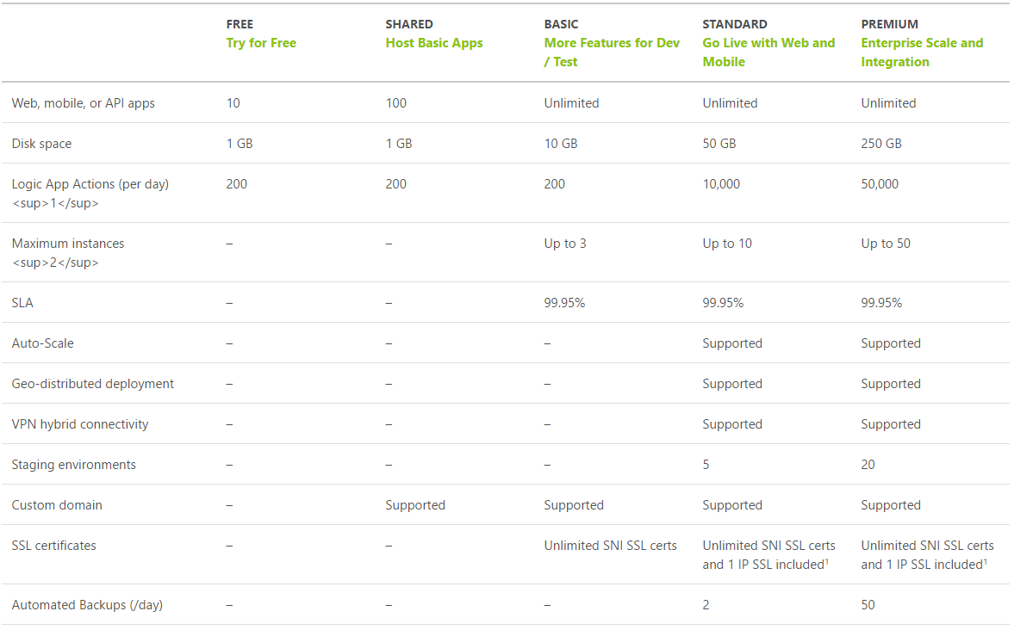
App Service Plan Tiers
https://azure.microsoft.com/en-us/pricing/details/app-service/plans/
Notes:
IF YOU’RE NOT USING SSL, YOU SHOULD BE. PERFORMANCE ISSUES HAVE BEEN ADDRESSED. GOOGLE WILL SHAME YOU IF YOU’RE NOT USING HTTPS!
ASE—APP SERVICE ENVIRONMENT USES A TIER ABOVE PREMIUM CALLED ISOLATED SERVICE TIER

Slide 32
App Service Plan
Represents the collection of physical resources used to host your apps
Region (West US, East US, etc.)
Scale count (one, two, three instances, etc.)
Instance size (Small, Medium, Large)
SKU (Free, Shared, Basic, Standard, Premium)
Web Apps, Mobile Apps, API Apps, Functions run in an App Service Plan
Notes:
In App Service, an app runs in an App Service plan. An App Service plan defines a set of compute resources for a web app to run. These compute resources are analogous to the server farm in conventional web hosting. One or more apps can be configured to run on the same computing resources (or in the same App Service plan).
ALL REGIONS ARE NOT CREATED EQUAL
WALMART LIFT AND SHIFT TO SOUTH CENTRAL
Create App Service Plans
Azure App Service plans in-depth overview
https://docs.microsoft.com/en-us/azure/app-service/azure-web-sites-web-hosting-plans-in-depth-overview?toc=%2fazure%2fapp-service-web%2ftoc.json

Slide 33
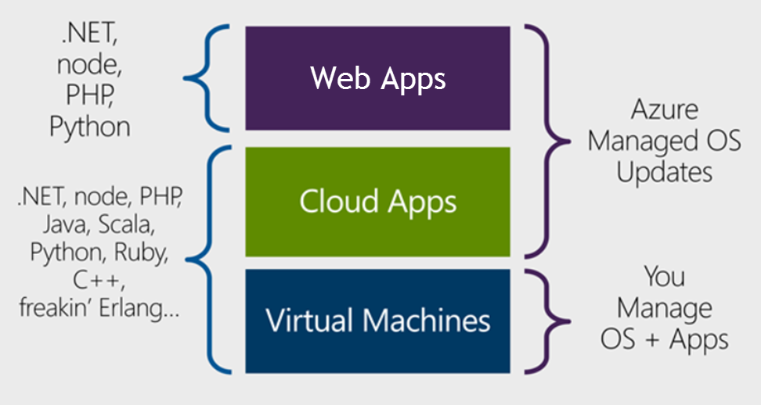
Design Azure App Service Web Apps
Notes:
EXAM: CLOUD APPS FAÇADE OVER IIS. VM PRE-CONFIGURED TO HOST YOUR APP OVER IIS.
PAAS TYPE WEB
IDEMPOTENT
Design Azure App Service Web Apps
Web Apps overview
https://docs.microsoft.com/en-us/azure/app-service-web/app-service-web-overview
https://docs.microsoft.com/en-us/azure/app-service-web/choose-web-site-cloud-service-vm#scenarios

Slide 34
Design Azure App Service Web Apps
Platform as a Service (PaaS)
Azure Resource Manager (ARM) Technology
Easy to use with existing development skills:
VSTS/Git/GitHub/etc. for deployment Visual Studio integration
Other Azure options for deploying web applications:
Virtual Machines (IaaS)
Service Fabric (Microservice architectures)
Cloud Services (Web Roles and Worker Roles) – Older ASM technology
Notes:
ASM = Azure Service Manager

Slide 35
Design Custom Web API
Web API is a one or more RESTful services (with one or more operations)
Endpoints expose services to external, partner or internal developers
Can implement in several technologies:
ASP.Net Web API
Node.js
App Service options:
Web App (if you need a web site too)
Mobile App
API App
Notes:
Design Custom Web API
Create a REST service using ASP.NET Web API and SQL Database in Azure App Service
https://docs.microsoft.com/en-us/azure/app-service-web/web-sites-dotnet-rest-service-aspnet-api-sql-database
https://azure.microsoft.com/en-us/services/api-management/

Slide 36
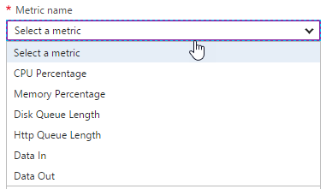
Design for Scalability and Performance
Scale Up – Change pricing tiers: Free, Shared, Basic, Standard, Premium
Scale Out – Change instance count: manually, auto
Scaling condition rules: Scheduled or Metric
Can have multiple condition rules
Can notify via email or webhook when autoscale events occur
Notes:
Design Web Apps for Scalability and Performance
Scale up an app in Azure
https://docs.microsoft.com/en-us/azure/app-service-web/web-sites-scale
Scale instance count manually or automatically
https://docs.microsoft.com/en-us/azure/monitoring-and-diagnostics/insights-how-to-scale?toc=%2fazure%2fapp-service-web%2ftoc.json

Slide 37
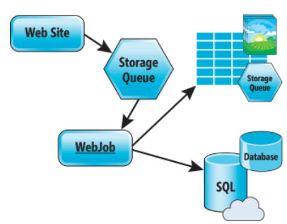
Design for Scalability and Performance
Design for Scale Out
Move towards stateless or at least distributed session/cache
Redis Cache for any Session/Cache needed
Move towards asynchronous UI
Queues for passing work off
Notes:
Azure Web Sites : Scaling Your Web Application with Azure Web Sites
https://msdn.microsoft.com/en-us/magazine/dn786914.aspx
Deploy Azure Web Apps to Multiple Regions for High Availability
Controlling Azure web app traffic with Azure Traffic Manager
https://docs.microsoft.com/en-us/azure/app-service-web/web-sites-traffic-manager
Add a Content Delivery Network (CDN) to an Azure App Service
https://docs.microsoft.com/en-us/azure/app-service-web/app-service-web-tutorial-content-delivery-network

Slide 38
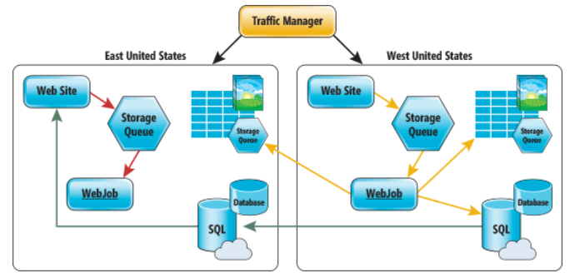
Deploy Azure Web Apps to Multiple Regions
Traffic Manager for routing traffic between regions
Performance – for directing user to closest region Failover – for secondary site Round Robin – for balancing traffic
CDN
Places static content close to user (images, media, etc)
Notes:
Deploy Azure Web Apps to Multiple Regions for High Availability
Controlling Azure web app traffic with Azure Traffic Manager
https://docs.microsoft.com/en-us/azure/app-service-web/web-sites-traffic-manager
Add a Content Delivery Network (CDN) to an Azure App Service
https://docs.microsoft.com/en-us/azure/app-service-web/app-service-web-tutorial-content-delivery-network
Best Practices: Windows Azure Websites (WAWS)
https://azure.microsoft.com/en-us/blog/best-practices-windows-azure-websites-waws/

Slide 39
Deploy
Web Deploy
Kudu (Git/Mercurial/OneDrive/Dropbox)
VSTS/Github/Bitbucket
Browser drag and drop (Chrome and Firefox)
FTP/FTPS
Filezilla, Windows Explorer
App Service infrastructure can be setup using PowerShell, Azure CLI or RM templates
Notes:
Deploy Web Apps
Deploy your app to Azure App Service
https://docs.microsoft.com/en-us/azure/app-service-web/web-sites-deploy

Slide 40
Update Web Apps with Minimal Downtime
Deployment Slots are live apps with their own hostnames
Only available for Standard or Premium App Service plans
Number of slots available depend on App Service Plan
App content and configurations can be swapped between two deployment slots
Not all settings and configurations are swapped
Some settings can be marked to not swap
Testing in Production feature allows you to spread traffic across multiple deployment slots
Notes:
Update Azure Web Apps with Minimal Downtime
Set up staging environments in Azure App Service
https://docs.microsoft.com/en-us/azure/app-service-web/web-sites-staged-publishing

Slide 41
What gets Swapped with a Deployment Slot?
Swapped | Not Swapped
App Settings – can be configured to not swap | Custom Domain Names
Connection Strings – can be configured to not swap | SSL certificates and bindings
General settings | Scale settings (only production slots are scalable)
Handler mappings | Publishing endpoints
Diagnostic logs settings

Slide 42
Design Web Apps for Business Continuity
Web/Mobile/API Apps
Multiple instances (single data center)
Multiple data centers with Traffic Manager to balance traffic
Backup/Restore
Notes:
Design Web Apps for Business Continuity
**Restore from Azure Backup Vault - SQL DB has to be set for long term retention
Built in HA for App Service, SQL Database and Storage
Business Continuity (BC) is defined as the capability of the organization to continue delivery of products or services at acceptable predefined levels following a disruptive incident. ( Source: ISO 22301:2012)
Controlling Azure web app traffic with Azure Traffic Manager
https://docs.microsoft.com/en-us/azure/app-service-web/web-sites-traffic-manager
Overview of business continuity with Azure SQL Database
https://docs.microsoft.com/en-us/azure/sql-database/sql-database-business-continuity
Designing resilient applications for Azure
https://docs.microsoft.com/en-us/azure/architecture/resiliency/

Slide 43
Configure Data Replication Patterns
Features Available
Blob storage: geo-redundant and read-access geo-redundant storage
SQL Database: geo-restore, geo-replicate
CosmosDB/DocumentDB: global replication
Custom Code
Can write WebJob to copy data to other regions or on-premise
Notes:
INGRESS IS FREE. OUTGRESS COSTS.
Configure Data Replication Patterns
Data Replication and Synchronization Guidance
https://msdn.microsoft.com/en-us/library/dn589787.aspx
Azure Storage replication
https://docs.microsoft.com/en-us/azure/storage/storage-redundancy

Slide 44
App Service Backup
Configure a storage account and container to store backup
Can store backup in another region
Configure schedule for backup to occur
Can optionally backup database also (as a bacpac file)
Exclude files with a _backup.filter file listing paths to exclude
Limit of 10GB of content for a backup (site files + bacpac)
Stores backup as .zip
Notes:
Back up and Restore Data
** For a database to appear in this list, its connection string must exist in the Connection strings section of the Application settings blade for your app.
Back up your app in Azure
https://docs.microsoft.com/en-us/azure/app-service-web/web-sites-backup
Restore an app in Azure
https://docs.microsoft.com/en-us/azure/app-service-web/web-sites-restore

Slide 45
App Service Restore
Restore options:
Replace existing app (backup was taken from)
Replace another app or create another app based on backup
Notes:
Back up and Restore Data
Restore an app in Azure
https://docs.microsoft.com/en-us/azure/app-service-web/web-sites-restore

Slide 46
Design for Disaster Recovery
Backup/Restore - is about data or workloads and getting them back to a known state and running.
Disaster Recovery - is about getting your systems up and running in another location.
Recovery time objective (RTO) – maximum acceptable time before the application fully recovers after the disruption.
Recovery point objective (RPO) – maximum amount of recent data updates (time interval) the application can tolerate losing.

Slide 47
Design for Disaster Recovery
How do you bring up a new site in a new location, if not using Traffic Manager?
1. Database Layer
Initiate unplanned failovers to bring secondary site up as primary
or perform geo-restore from replicated backup
2. Storage Layer
If only have read only access, need process to copy in order to read/write
3. Web Layer
Restore from backup (stored in storage account for failover site)
or Redeploy from RM templates and code from Releases repository
4. Fix up connection strings
Notes:
Design for Disaster Recovery
Availability checklist
https://docs.microsoft.com/en-us/azure/architecture/checklist/availability
Best Practices: Windows Azure Websites (WAWS)
https://azure.microsoft.com/en-us/blog/best-practices-windows-azure-websites-waws/
Disaster recovery (DR) involves a set of policies and procedures to enable the recovery or continuation of vital technology infrastructure and systems following a natural or human-induced disaster.

Slide 48
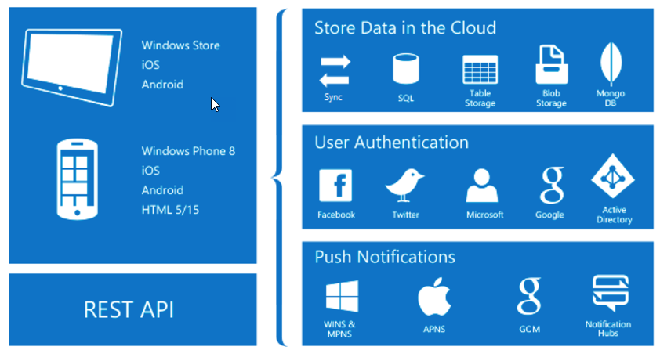
Design App Service Mobile Apps
Native and Cross Platform
Connect your enterprise
Build offline-ready apps
Scalable Push Notifications
Client SDKs:
iOS
Android
Windows
Xamarin
Cordova
Notes:
What is Mobile Apps?
https://docs.microsoft.com/en-us/azure/app-service-mobile/app-service-mobile-value-prop

Slide 49








Offline Sync Capabilities
Mobile Client App – use platform specific SDKs and local data stores
SQL Lite or Core Data on iOS
Server endpoint – use SDK TableController base class for table syncing
Mobile Client App using SDKs
Mobile App/API App or Web App using SDKs
SQL Lite/Core Data
IMobileServiceSyncTable
TableController<T>
Notes:
Integrate Offline Sync Capabilities Into an Application
Offline Data Sync in Azure Mobile Apps
https://docs.microsoft.com/en-us/azure/app-service-mobile/app-service-mobile-offline-data-sync

Slide 50
Extend Mobile Apps using Custom Code
Mobile Client SDKs available for:
Android
Apache Cordova
iOS
Windows
Xamarin.Android
Xamarin.Forms
Xamarin.iOS
Notes:
Extend Mobile Apps using Custom Code
Android
https://docs.microsoft.com/en-us/azure/app-service-mobile/app-service-mobile-android-how-to-use-client-library
Cordova
https://docs.microsoft.com/en-us/azure/app-service-mobile/app-service-mobile-cordova-how-to-use-client-library
iOS
https://docs.microsoft.com/en-us/azure/app-service-mobile/app-service-mobile-ios-how-to-use-client-library

Slide 51
Implement Mobile Apps Using Microsoft .NET or node.js
Mobile App server SDKs available for:
.NET
Node.js (has Easy Tables and Easy APIs available in portal)
SDKs provide:
Table operations for data access
Custom API operations
Push Notifications
Integration with Authentication
Notes:
Implement Mobile Apps Using Microsoft .NET or node.js
.NET
https://docs.microsoft.com/en-us/azure/app-service-mobile/app-service-mobile-dotnet-backend-how-to-use-server-sdk
Node.js
https://docs.microsoft.com/en-us/azure/app-service-mobile/app-service-mobile-node-backend-how-to-use-server-sdk

Slide 52
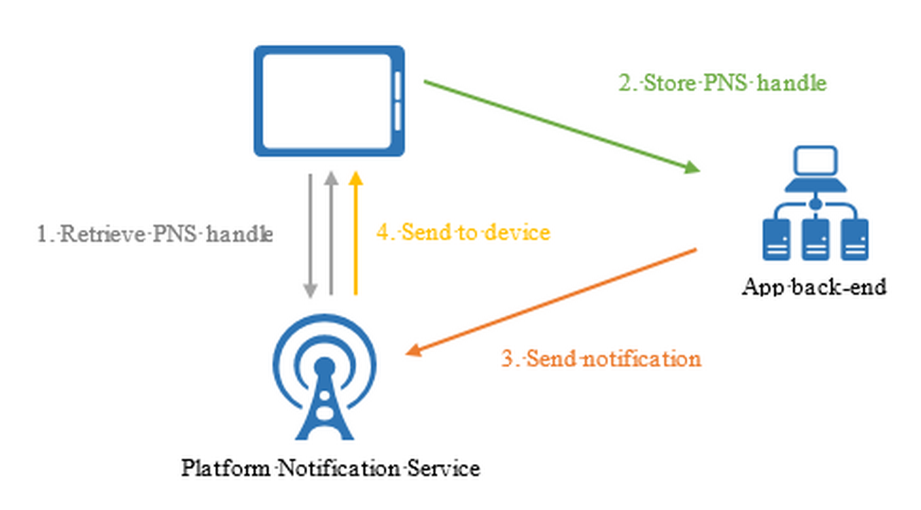
Implement Push Notification Services in Mobile Apps
Abstracts the choreography to support push notification to mobile clients
Apple Push Notifications (APNS)
Google Cloud Messaging (GCM)
Windows (WNS)
Windows Phone (MPNS)
Amazon (ADM)
Notes:
Implement Push Notification Services in Mobile Apps
Add push notifications to your Windows app
https://docs.microsoft.com/en-us/azure/app-service-mobile/app-service-mobile-windows-store-dotnet-get-started-push

Slide 53
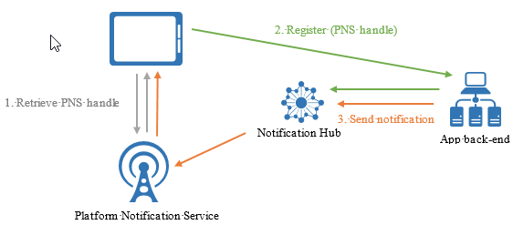
Send Push Notifications
Push on the App Service menu - Uses Notification Hubs
Broadcast to one or multiple platforms
Push to device or user
Push to segment with dynamic tags
Localized push
Silent push
Scheduled push
Direct push
Personalized push
Notes:
Send Push Notifications to All Subscribers
Send Push Notifications to Specific Subscribers
Send Push Notifications to a Segment of Subscribers
Azure Notification Hubs
https://docs.microsoft.com/en-us/azure/notification-hubs/notification-hubs-push-notification-overview

